Slide 1


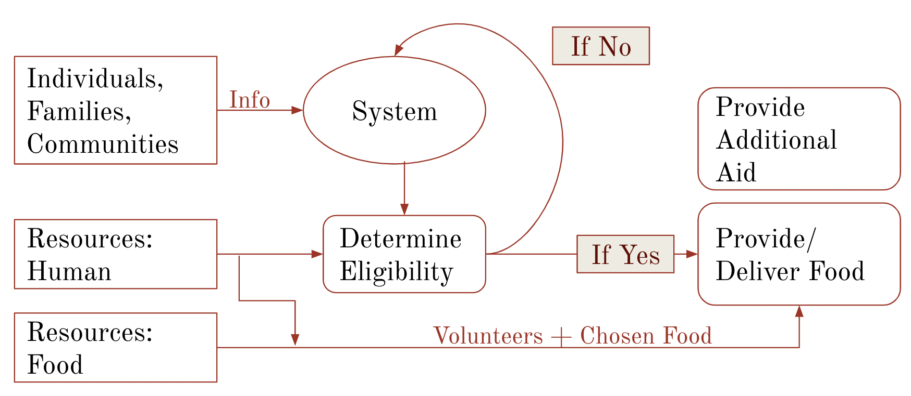
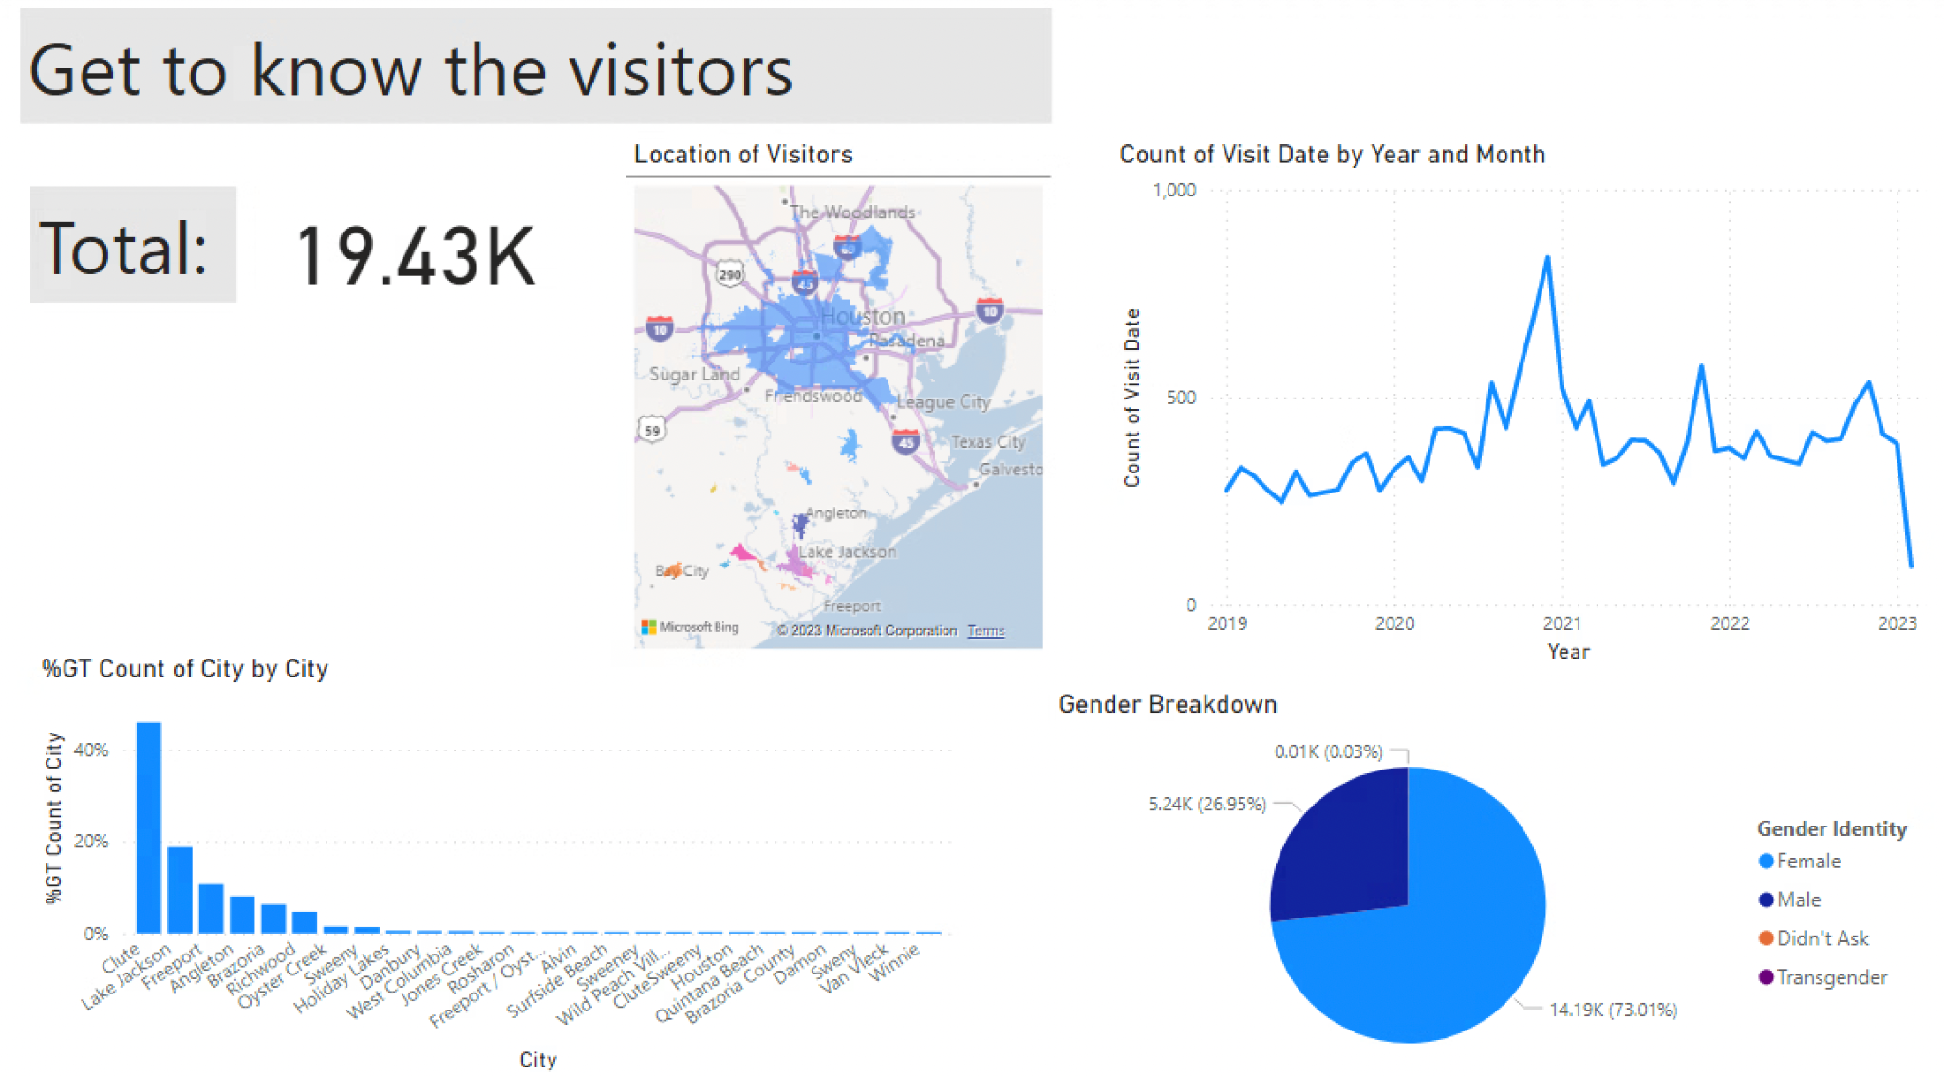
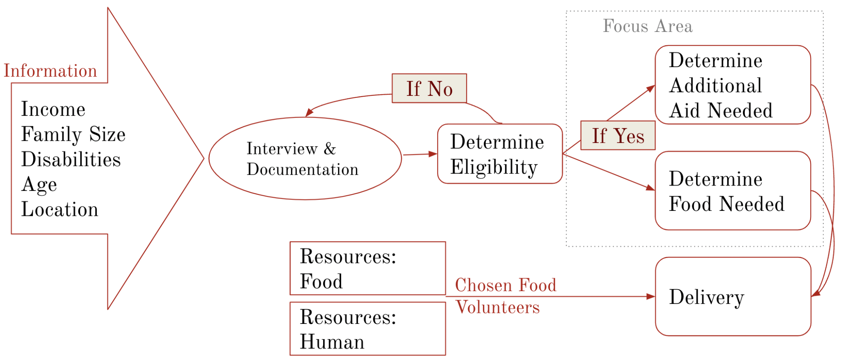
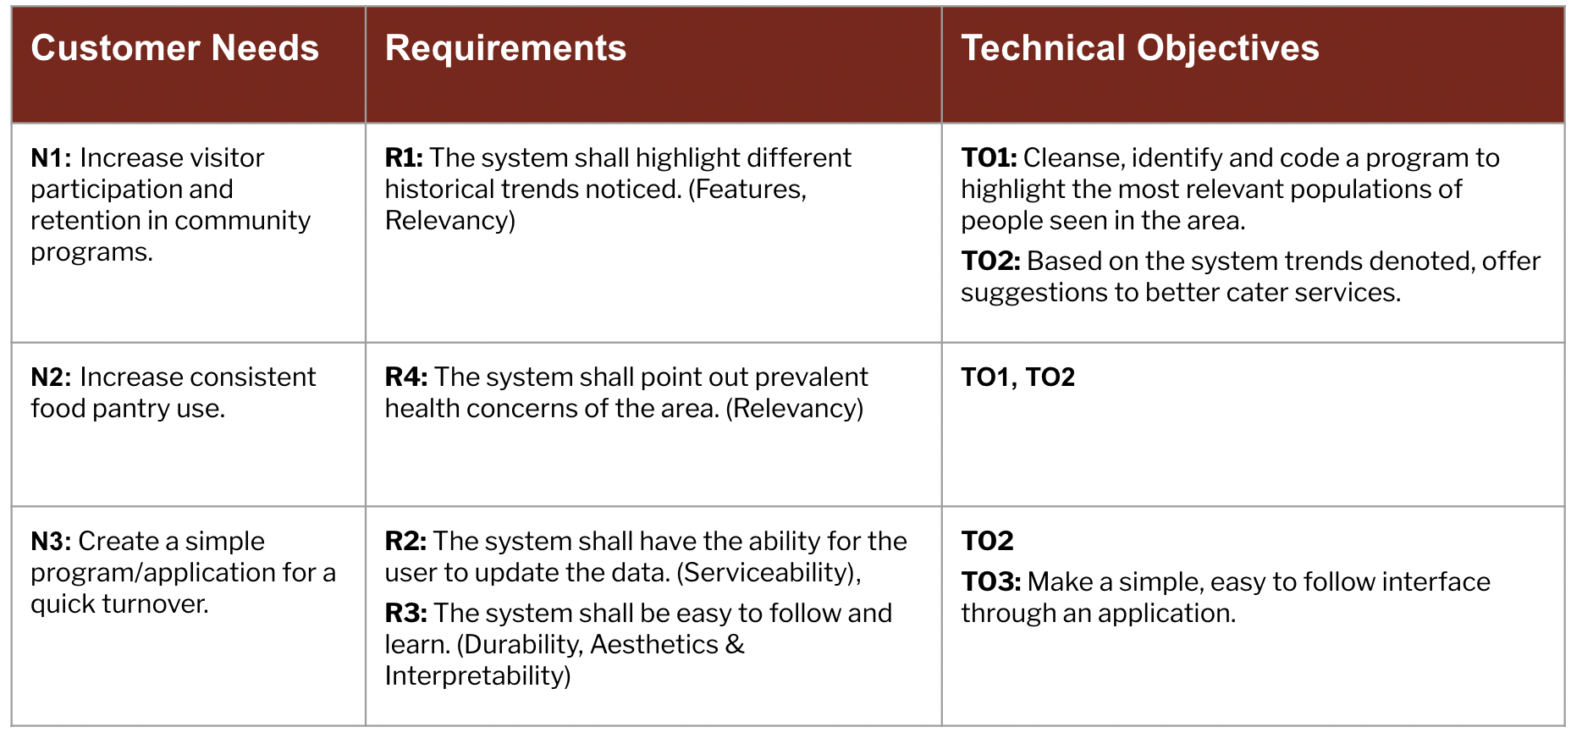
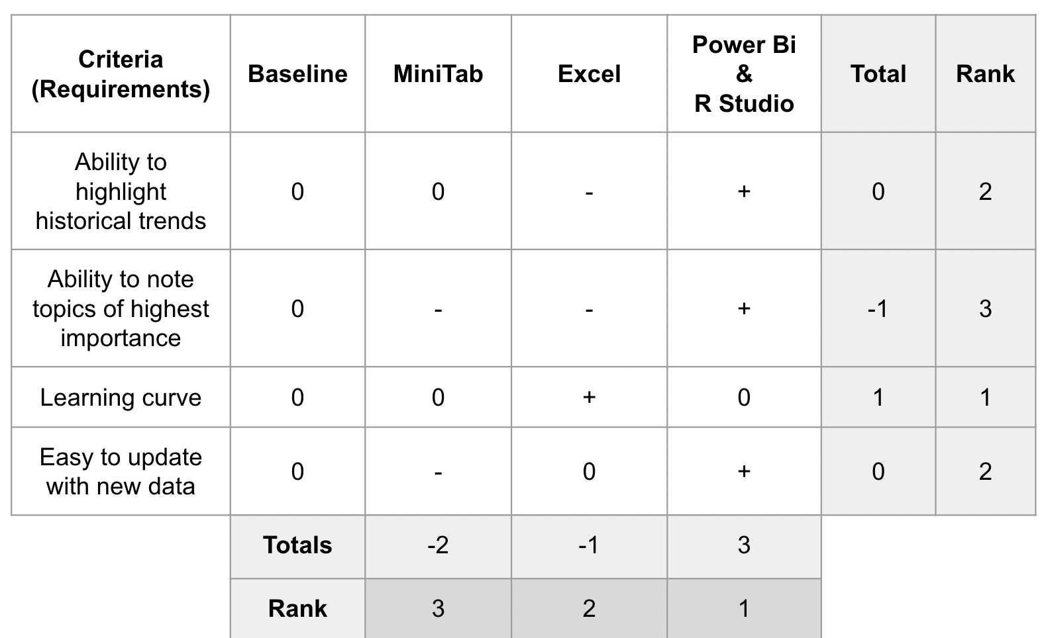
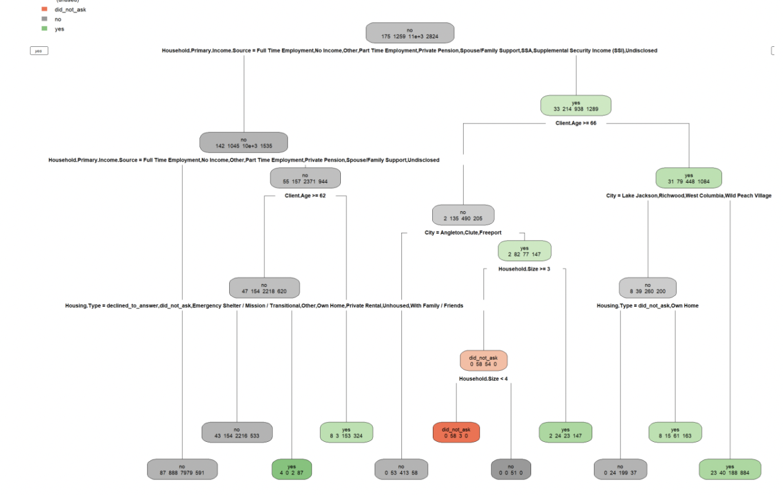
EPS Booth: 246
The Food Basket
Abigayl Seams, Chris Notzon, Judie Garcia, Maribel Vazquez
Dr. Michael Do
Problem Definition
The generic programs and supplies at The Food Basket have led to a reduction in visitor turnout, participation, and inconsistent retention rates.
We aim to complete a data analysis to highlight trends to allow for better personalized programs and bettering visitor retention.
Engineering Analysis
Altering the Process
Adding in a step at the end to advertise specific programs based on the data received from the visitors
Figure 2. CONOPS demonstrates the current vs. future goal of the process
Data Sanitization & Trends Analysis
Utilized RStudio code to scan the large excel file for empty cells
RStudio also highlighted the most relevant answers through decision trees
Figure 3. An example of the RStudio Decision Trees
Engineering Analysis - cont’d
Trend Highlighting
Utilized PowerBi to represent the trends through data driven dashboards
Outcomes - cont’d
Changes Over Time The current trends were found from analyzing the past 5+ years. This includes spikes in needs such as during the start of the COVID-19 pandemic. While this data is meaningful for identifying the most common needs and the areas most likely to require assistance in the case of an emergency, the years of most visitors and least visitors can be opted out or included as needed.
Methodology
Upon being presented with an excel sheet containing the past 5-6 years of historical visitor data, we were introduced with the challenge of picking the best application to utilize.
Impact
Once the Food Basket has implemented this project’s deliverables, we hope to see:
Overall better visitor retention
Better involvement and participation rates at community programs
An improvement in the forecast capabilities of the Food Basket
Stronger plans for resource collection and distribution
A tool that the Food Basket can continuously use, updating with new data as it is received
This is the first form of data analysis implementation into the Food Basket system. If retention increases for this local food pantry, we hope these data analysis methods will improve organically, and help other food pantries and food banks.
Table 1. Defining the requirements of the project
Figure 4. An example of our PowerBi Dashboards
Outcomes
After sanitizing the data and analyzing the remaining values, the largest trends were found in location. Additional patterns were found in age and financial status. The data collected on location will serve as a priority list for planning upcoming community events. The specified trends in needs will serve as a forecast for resource allocation, ideally affecting the resource collection from here onward.
Once new data is collected, it can be sanitized and analyzed using the same methods as done here. Trends may change once new programs and targeted supplies are acquired. Ideally trends will become more accurate by the month and the most responsive patterns will become apparent by analyzing the retention rates after hosting new programs and offering targeted aid.
References
Interfaith Food Bank. (2017). Community Events. Retrieved from https://www.interfaithfoodbank.com/
Acknowledgements
This would not have been possible without Michael Rowland, Sam Crabtree, and Tom Crawford. Thank you for being a huge help from beginning to end.
Figure 1. Our Pugh Chart weighing all of the alternative options against our requirements

